Slide 1

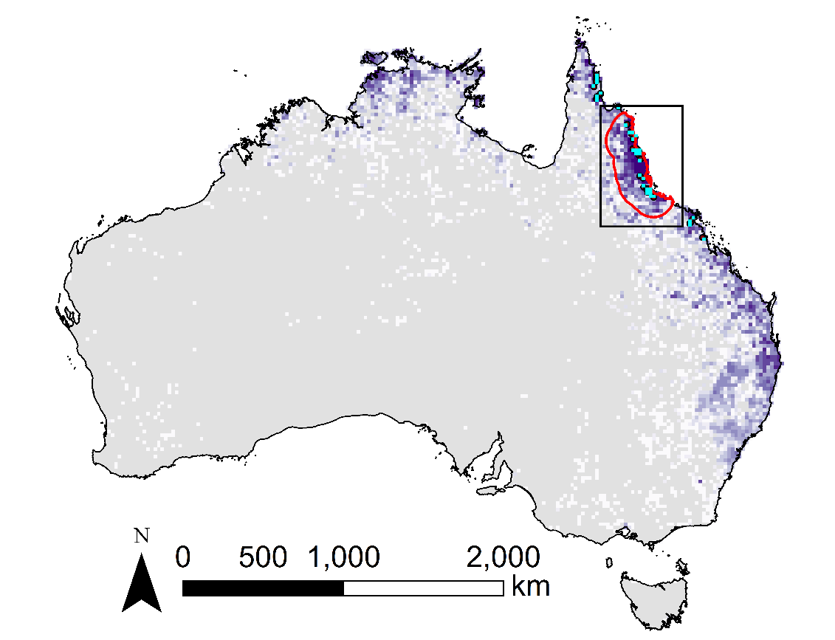

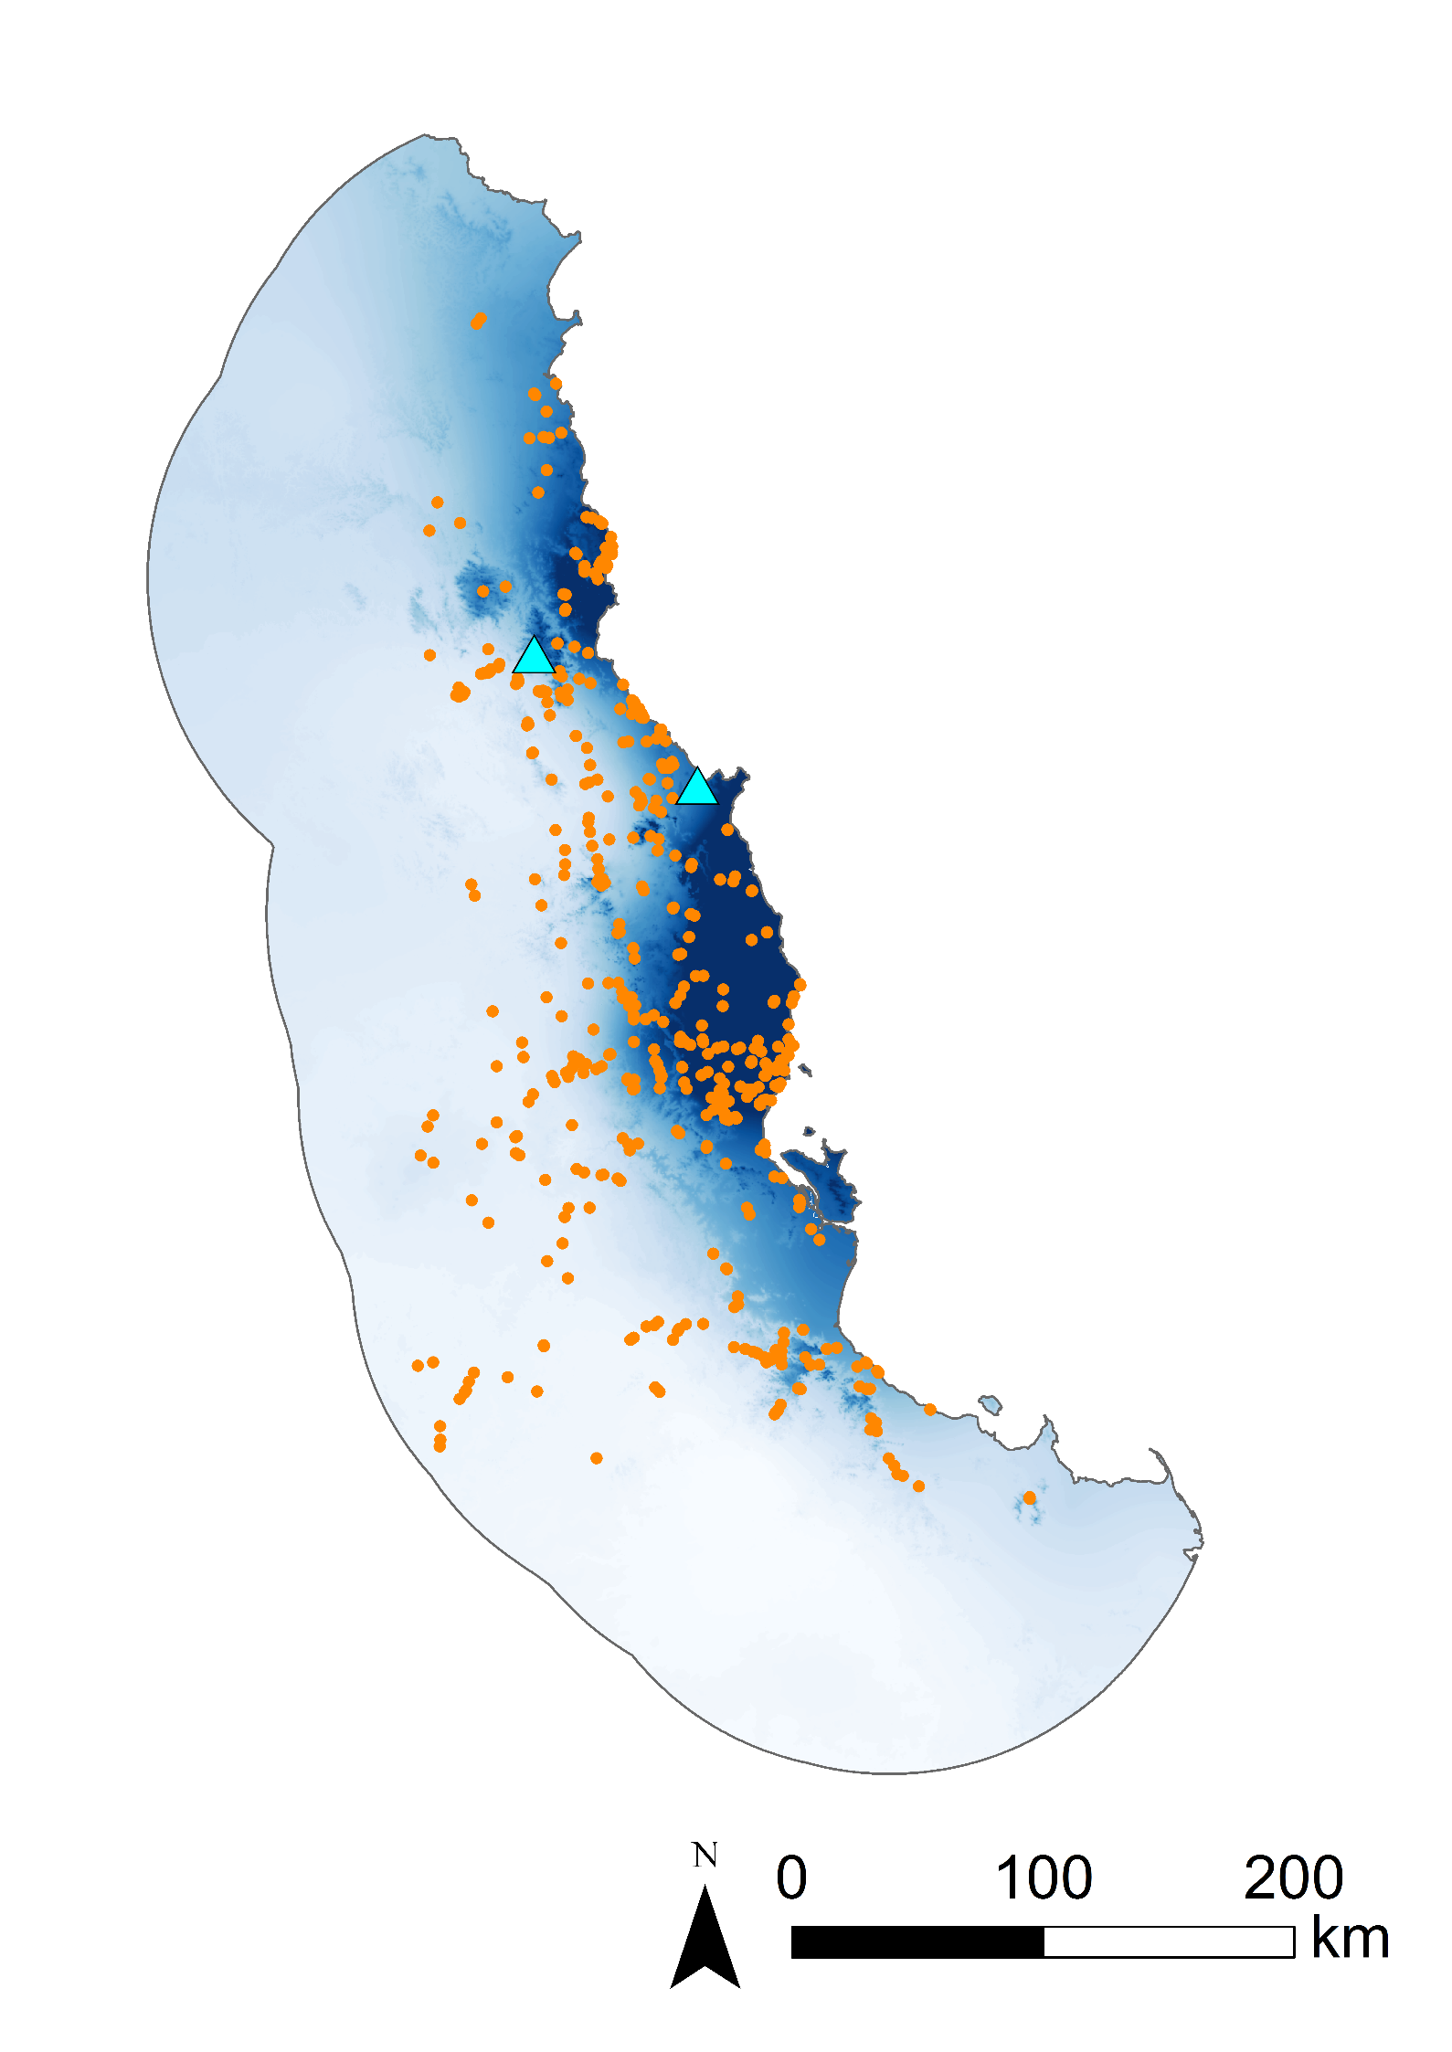
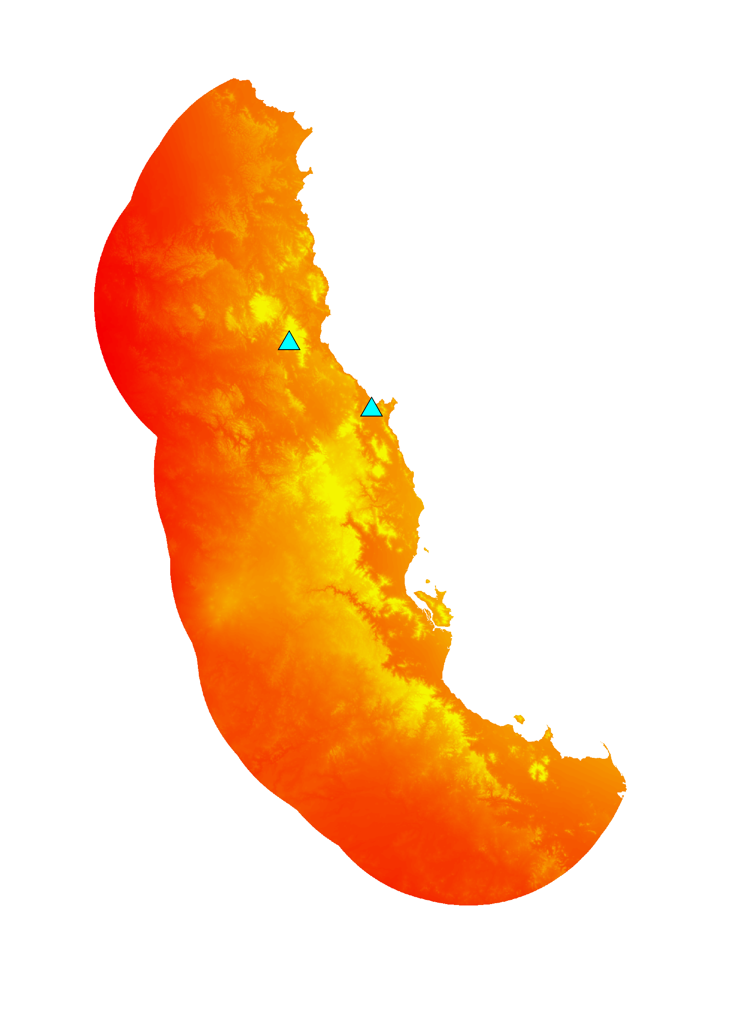


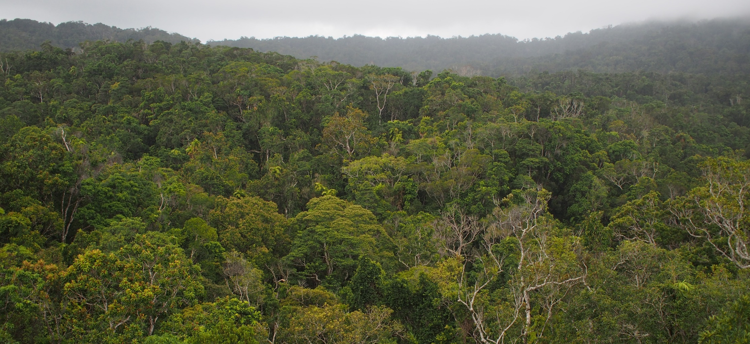
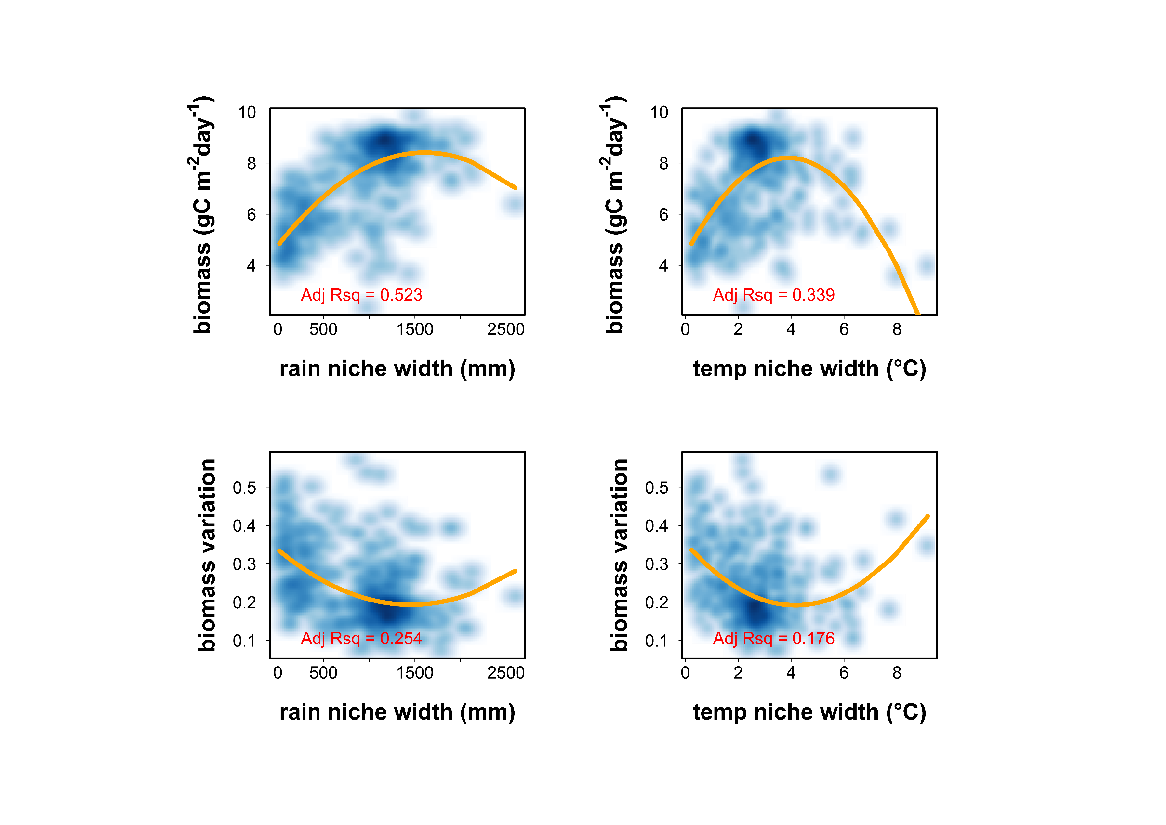
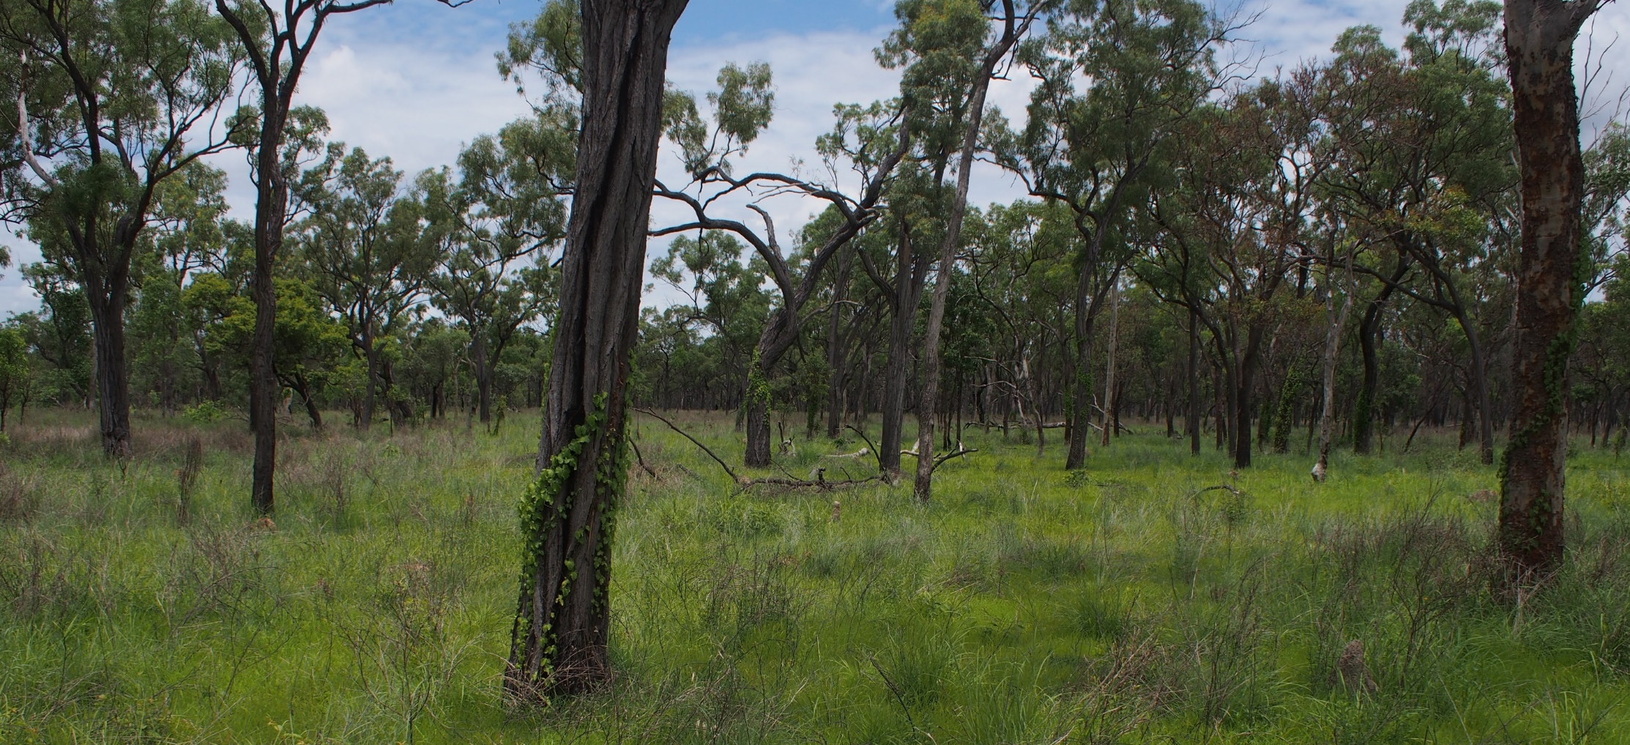
Bioregional primary productivity and community-level niche width
ECOSYSTEM & BIODIVESRITY KNOIWLEDGE
LAND & WATER FLAGSHIP
macroecologicalmodelling.com
Hugh Burley¹, Karel Mokany¹, Simon Ferrier¹ and Shawn Laffan²
¹UNSW school of BEES, Sydney Australia. ²CSIRO Land and Water, Canberra Australia.
Aim
Structural equations
Future directions
Conserving different spatio-temporal dimensions of biological diversity may help maintain ecosystem functions such as primary productivity under global change. The range of environmental conditions that plant species occupy - their environmental niche widths - approximate the degree of ecological specialisation in a community, potentially influencing current primary productivity (Fig. 1).
rainfall
Preliminary models suggest the influence of community mean niche width on primary productivity is greater than either rainfall or temperature themselves. However, community mean leaf area is a stronger influence on primary productivity than temperature niche width. Communities with wider mean rainfall niches have greater magnitude and lower variation of primary productivity. Conversely, communities with narrower mean temperature niches have greater primary productivity magnitude and lower variation.
Further modelling could incorporate the effects of spatial non-stationarity and phylogenetic relationships between species on ecosystem functions such as primary productivity.
0.617
-0.073
community
mean rainfall niche width
R² = 0.381
environment
0.243
community
mean
leaf area
R² = 0.922
1.004
community
mean
leaf area
community
mean
environmental niche width
-0.216
Data sources
community
GPP
magnitude
R² = 0.504
0.734
A).
community
GPP
magnitude
variation σ
-
-
-
x
+
σ
x
rainfall
Fig. 1). Conceptual equation predicting wider community mean niche widths drive lower magnitude and greater variation of community primary productivity.
0.617
We use structural equation models to test whether mean community niche width influences the magnitude and variation of community primary productivity in the Australian Wet Tropics, above and beyond community mean traits values (e.g. leaf area) and current environmental conditions.
-0.073
-0.072
community
mean
leaf area
R² = 0.922
1.004
community
mean rainfall niche width
R² = 0.381
Tree richness in 20km cells
Niche width
> 56
Wet Tropics study region
-0.122
1
Continental distribution of Argyrodendron polyandrum; rain niche width = 797 mm
temp niche width = 3.86 °C
Species niche width (NW, Fig. 2) is defined as the middle 90% of rainfall (mm) and temperature (°C) values for all geographic records of Wet Tropics tree species across Australia. Trees with niches centred beyond the middle 90% of temperature values OR the driest 5% of rainfall values for the Wet Tropics - based on their geographic records - were excluded from analysis. Community niche width is defined as the average niche width of all tree species occurring at each of 492 Wet Tropics sites.
community
GPP
variation
R² = 0.213
-0.297
B).
temperature
CAIRNS
MOUNT CARBINE
species c).records
NW c
-0.141
community mean rainfall
niche width =
mean(NW a, b, c)
-0.105
community
mean temp niche width
R² = 0.020
species b). records
NW b
-0.186
community
mean
leaf area
R² = 0.666
0.794
species a). records
NW a
1.057
community
GPP
magnitude
R² = 0.545
-0.589
Rain (mm)
527 community surveys (745 tree species)
Temp (°C)
low rainfall
site i
high rainfall
6945
36.8
Fig. 2). Quantifying community mean rainfall niche width for a hypothetical site.
542
24.1
Bivariate regressions
temperature
C).
-0.141
-0.105
community
mean temp niche width
R² = 0.020
CAIRNS
Tall closed rainforest, annual rainfall ~2800 mm, max temp of warmest period ~ 31.8 °C, tropical monsoonal climate
-0.174
community
mean
leaf area
R² = 0.666
0.794
-0.618
community
GPP
variation
R² = 0.254
0.260
MOUNT CARBINE
Eucalypt low open woodland, rainfall ~945 (mm), temp ~32.2°C, Tropical wet-dry savannah climate
Fig. 4). Observed variable structural equation models, assuming all variables are measured directly. Single headed arrows represent hypothesised causal paths. Positive standardised path coefficients are in blue, negative in red and non-significant paths are dashed (α = 0.05). Arrow width is proportional to strength of path coefficients,.
Fig. 5). A). 100,00 continental geographic records for 745 trees from the Atlas of Living Australia (http://www.ala.org.au/). B). 527 10m × 50m vascular plant community surveys, with 745 trees recorded at the sites that were within the Wet Tropics environmental extremes. Sites are overlain with interpolated 250m surfaces (1976-2005) of annual rainfall (mm, blue) and maximum temperature of the warmest period (°C, orange) C). Example vegetation communities of north Queensland, Australia, near Cairns, top, and Mount Carbine, bottom.
Fig. 3). Scatterplots of primary productivity magnitude (average daily gross primary productivity in grams of carbon from 01/2001-12/2012) and variation (ratio of the standard deviation in primary productivity to the mean) for 492 Wet tropics tree communities. Second order polynomial regression lines are plotted in orange.

